Slide 1



CHM 103 ORGANIC CHEMSTRY I
Department of Chemical Sciences
Faculty of Science and Technology
Bingham University, Karu
Course Lecturer: Joseph C. Oguegbulu
Joseph.oguegbulu@binghamuni.edu.ng

Slide 2
COURSE CONTENT
PART A – Mr. Joseph
Introduction. History, classifications 0.5 week
Carbon: Bonding in organic compounds, structure 0.5 week
Functional groups 0.5 week
IUPAC nomenclature 1 week
Isomerism – Structural & Stereo-isomerism 2 weeks
Hybridisation – Resonance effects & others 2 weeks
PART B – Assoc. Prof. Okoli
Alkanes, Alkenes, Alkynes
Alkyl halides, Alkanols
Carbonyl compounds: Alkanals and Alkanones.

Slide 3
LECTURE I
INTRODUCTION/GENERAL INFORMATION
BACKGROUND
COURSE CONTENT
HISTORICAL PERSPECTIVE
FLASHBACK: SOME BASIC CONCEPTS

Slide 4
ORG. CHEM.: A HISTORICAL PERSPECTIVE
If CHM 101A is PHYSICAL CHEMISTRY, why do we do CHM 103???
Why is Organic Chemistry studied?

Slide 5
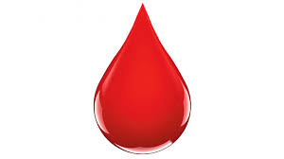
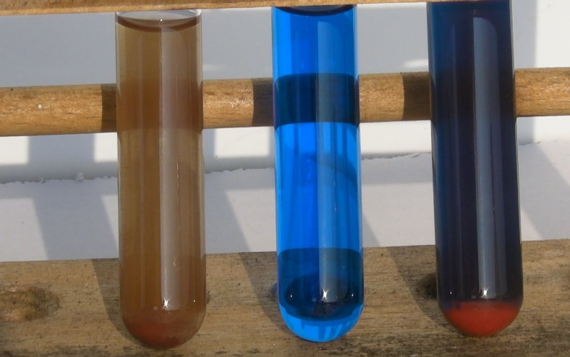
A HISTORICAL PERSPECTIVE: Vitality
Historically, substances that exist in biological systems such as blood, sweat, urine, cholorophyl, rubber, semen, etc were thought to be different from ‘test tube compounds’
They were regarded as possessing a “Vital Force”
This was regarded as the “Theory of VITALITY”
They could not be synthesised from inorganic components
But this was not true!!!

Slide 6
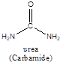
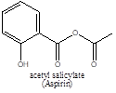
THEORY OF VITALITY DEBUNKED
This idea was held until the 19th century (i.e. 1800s)
UNTIL THE FOLLOWING HAPPENED
Synthesis of carbamide (urea) (Friedrich Wholer1828)
NH4⁺ + ⁻OCN ---------> H₂N-CO-NH₂ (Urea)
Making of soaps from fats&oils (Michel Chevereul 1816)
Synthesis of Perkin’s mauve (Willian Perkins 1856).
Manufacture of aspirin (acetyl salicylate) (1899)

Slide 7
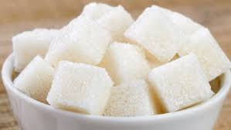
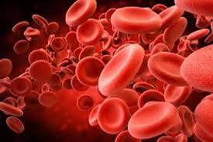
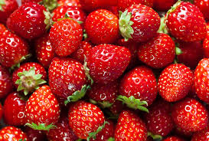
ORGANIC CHEMISTRY: Introduction
Today Organic chemistry is better understood
Org. Chem. is “The chemistry/study of carbon (C) and its compounds”
Also called “Chemistry of Life”
Reason: Lots of compounds found in biological systems are studied
Every organic compound contains carbon
However, not all compounds containing carbon are ‘Organic’ e.g. CO₂, HCO₃ etc.

Slide 8
ORGANIC CHEMISTRY: Introduction
Organic Chemistry Studies…
Hydrocarbons
Biomolecules
Organometallics
Petrochemicals
Natural products, etc

Slide 9
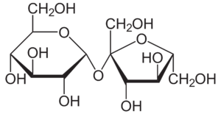
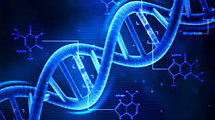
BIOMOLECULES
There are FOUR (4) classes of biomolecules
Carbohydrates (Glucose, sucrose, starch, chitin)
Proteins(Enzymes, receptors, antibodies, skin, hair)
Lipids (Fats, oils, phospholipids, steroids)
Nucleic acids (RNA, DNA)
Sucrose
A Lipid
DNA

Slide 10
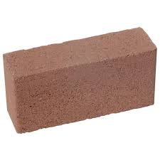
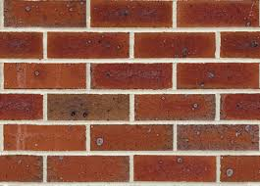
BIOMOLECULES
They are macromolecules (very large molecules) found in nature and biological systems
Sometimes called Biopolymers when made up of monomer units
Proteins <== amino acids
Cabohydrates (sugars) <== monosacharides
Nucleic acids <== single DNA, RNA units
Lipids <== NOT POLYMERS
Monomer
Polymer

Slide 11
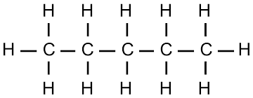
WHY IS CARBON SO SPECIAL
Catenation: Ability to form long carbon to carbon chains. C-C-C-C-C-C. Have you ever seen N-N-N-N-N- or O-O-O-O-O? NO
Strength of the Carbon to Carbon bond
C-C = 350 KJ/mol, N-N =160 KJ/mol, O-O = 150 KJ/mol
Ability to fully utilise its valence electrons
Valence electrons are outermost electrons
E.g. O has 6, but uses 2, N has 5, uses 3, C has 4, uses 4
Different Degrees of Unsaturation; C-C (Saturated);
C=C and C=C (unsaturated)

Slide 12
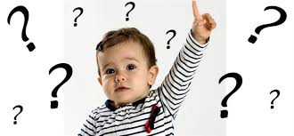
QUESTIONS???

Slide 13
CLASSIFICATION OF ORGANIC COMPOUNDS
Organic compounds can be generally classified as…
HYDROCARBONS &
NON- HDROCARBONS
Hydrocarbons: Containing only C and H
Non-Hydrocarbons: Any organic compounds containing N, O, S, Cl, Br, F, (heteroatoms)

Slide 14
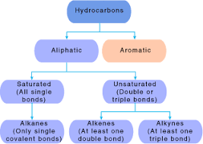
HYDROCARBONS
Broadly classified as….
ALIPHATIC
AROMATIC

Slide 15
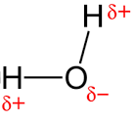
TUTORIAL II: Classification of Org Cmpds
Q4:How would you classify the following compounds?
B
C
D
A
G
H
I
E
F

Slide 16
WHAT MAKES A COMPOUND AROMATIC?
Compound must be cyclic
Compound must have a system of conjugated double bonds
Double-single-double-single-double-single…
Compound must obey Huckel’s rule
i.e. The number of pi-electrons in the molecule must = 4n + 2
Where ‘n’ is any integer, 1,2,3,4,5,6………
Simply put; aromatic cmpds have 6 or 10 or 14 or 18…etc. pi - e⁻
The atoms must be co-planar: i.e. must be on one plane

Slide 17
QUESTIONS???

Slide 18
CONDITIONS FOR AROMATICITY
Q5
Which of these compounds would NOT be aromatic?
Give reasons

Slide 19
FLASHBACK
Refresh your memory…
Element, atom, molecule, ion
Neutrons, protons, electrons
Atomic number, mass number
Bonding
Functional groups
etc

Slide 20


Slide 21
CHM 103 ORGANIC CHEMSTRY I
Department of Chemical Sciences
Faculty of Science and Technology
Bingham University, Karu
Course Lecturer: Joseph C. Oguegbulu
joseph.oguegbulu@binghamuni.edu.ng

Slide 22
LECTURE III
BONDING IN ORGANIC MOLECULES
IONIC
COVALENT
POLAR COVALENT BONDING
SOME INTERMOLECULAR BONDING
PARTICULARLY HYDROGEN BONDING

Slide 23

OBJECTIVES: At the end, you should be able to…
Explain bonding in organic cmpds
Differentiate between ionic, covalent and polar covalent bonds
Differentiate b/w intra-molecular and inter-molecular bonding
Explain Hydrogen bonding examples

Slide 24
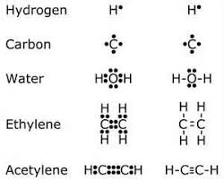
BONDING IN ORGANIC MOLECULES
The attractive force between atoms
Only valence electrons are involved
Every chemical bond has 2 electrons
Valence electron =outermost electrons
Atoms seek to attain greater stability by reaching an Octet or duplet
Can be Intramolcular (ionic, covalent) or Intermolecular (hydrogen bonding, v.d.w, dipole-dipole, etc)

Slide 25
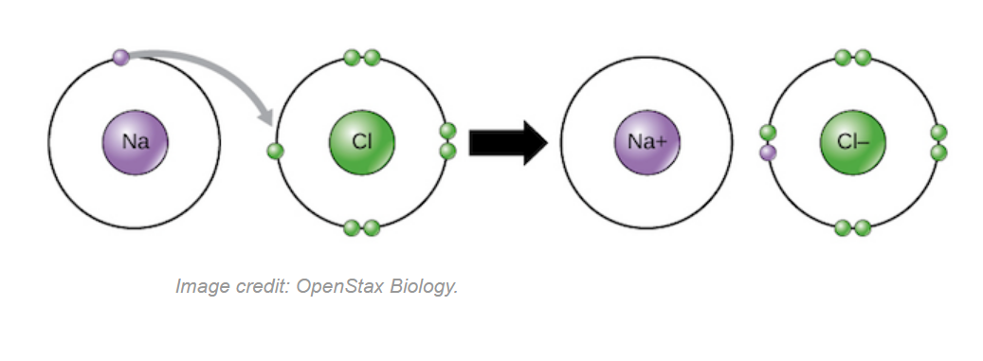
IONIC BONDING
Electron gain/loss gives an atom a filled valence shell
Hence, atoms become more stable by gain/loss of electrons
When they do so, ions are formed (cations and anions)
Ionic bonds are formed b/w oppositely charges ions
E.g. +vely charged (Na⁺) & -vely charged chloride ions (Cl⁻)
To make sodium chloride NaCl (table salt)
All ionic compounds are Polar

Slide 26
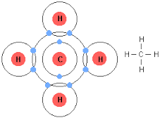
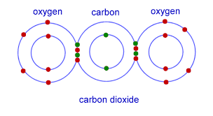
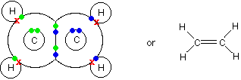
COVALENT BONDING
Occurs by electron sharing between atoms of same or different elements
More common in Organic Chemistry
B/c carbon mostly bonds covalently
Two/three e- pairs may be shared between atoms, resulting in single, double, or triple bonds respectively
CH₄
CO₂
H₂C=CH₂

Slide 27
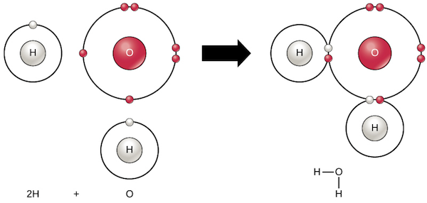
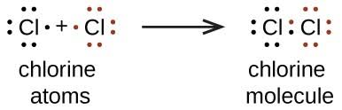
COVALENT BONDING
Also found in smaller inorganic molecules e.g. H₂O, CO₂, O₂ Cl₂
Covalent Bonds can be…
Polar covalent bonds or
Non-polar covalent bonds
Depending on the two atoms involved
Water molecule
Polar-covalent bond
Non-polar bond

Slide 28
POLAR COVALENT BONDING
Covalent bonds can be polar in nature if
There’s electronegativity difference bw 2 covalently bonded atoms
Q3…What is electronegativity???
Think of it as the tendency of an atom to attract electrons
Groups 5,6,7 = Generally electronegative; Groups1,2,3, = Not
There’s no electronegativity diff. b/w C-C or Cl-Cl or O-O, C-H
There’s electronegativity diff. b/w C-O, H-O, C-Cl, C-N, etc

Slide 29
POLAR COVALENT BONDING
In Polar covalent bonds, the bond electrons are unequally shared by the two bonded atoms
The e⁻ spend more time closer to the electronegative atom
O, N, S, Cl, Br, F are examples of electronegative atoms
E.g. in a H-O bond, the bonding e⁻ are closer to O than H
Hence creating slight (+) & (-) charges on atoms
E.g. H₂O, CH₃Cl, NH₃, CH₃NH₂ are all polar because of this

Slide 30
POLAR COVALENT vs NON-POLAR COVALENT
Q6
Classify the following bonds as either “Polar covalent” or “Non-polar covalent”
C-O
C-C
O-H
C-N
C-Li
O-O
C-H

Slide 31
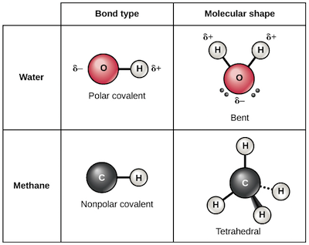
POLAR COVALENT vs NON-POLAR COVALENT
Polarity in organic compounds affects their physical and chemical properties such as
Melting and boiling points
Stability and reactivity, etc
This is largely because polar organic cmpds can undergo…
HYDROGEN BONDING

Slide 32
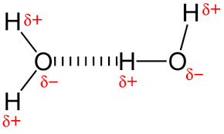
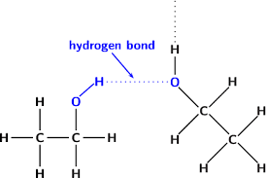
HYDROGEN BONDING
A type of INTER-MOLECULAR bonding
i.e. only exists between molecules
Not within a molecule
Only exists where there is
A Polar hydrogen (HBD) &
An electronegative atom (HBA) e.g. O, N, X in the neighbouring molecules
Other intermolecular bond types e.g. van da Waal exist in nonpolar cmpds

Slide 33
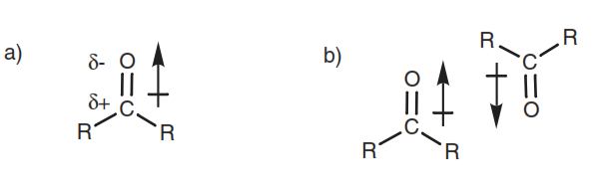
OTHER INTERMOLECULAR BOND TYPES
Other intermolecular bond types include
van da Waal (B/w Non-polar cmpds)
Dipole-dipole interactions (B/w Polar cmpds)
Electrostatic interactions (B/w Polar cmpds)
Metallic bonding (B/w metals). etc

Slide 34
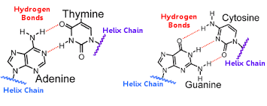
DID YOU KNOW???
Hydrogen bonding is one of the most important things in nature!
It’s the reason water boils at 100ºC (very high for a small molecule like H₂0)
It is also responsible for the integrity of GENETIC information by holding together your DNA
It also keeps your DNA Stands together!!!

